Slide 1

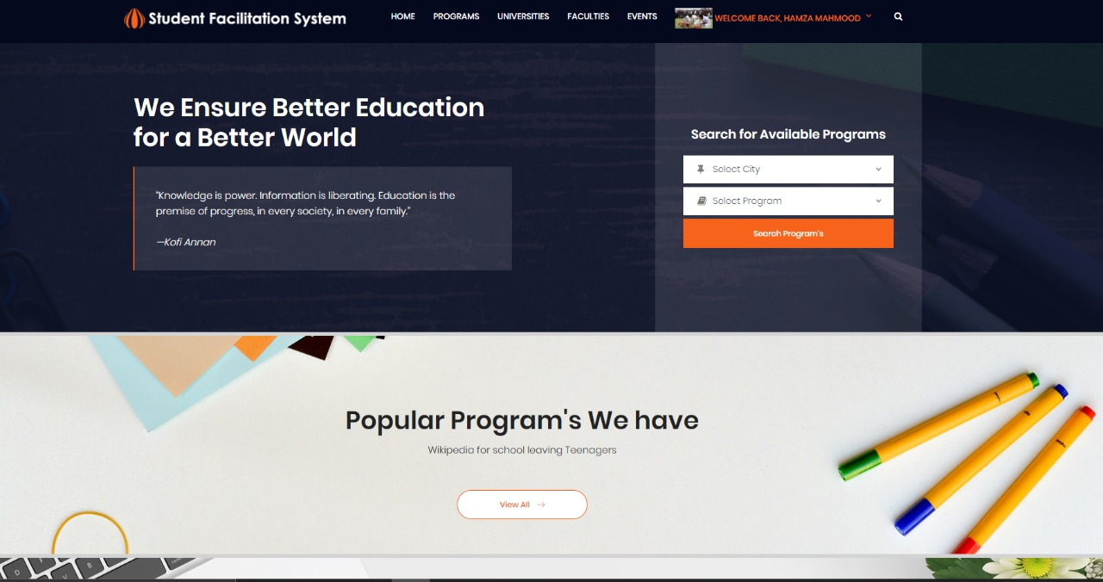
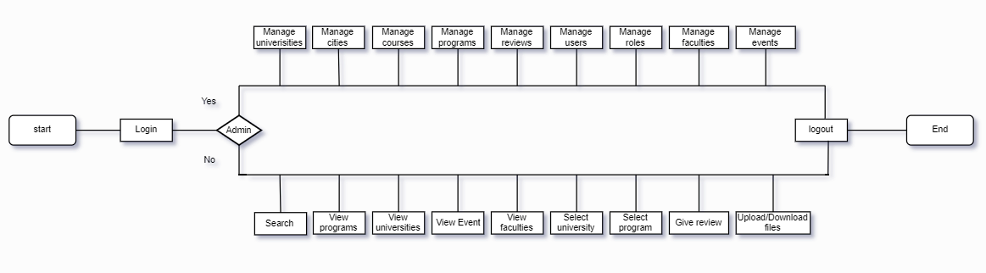
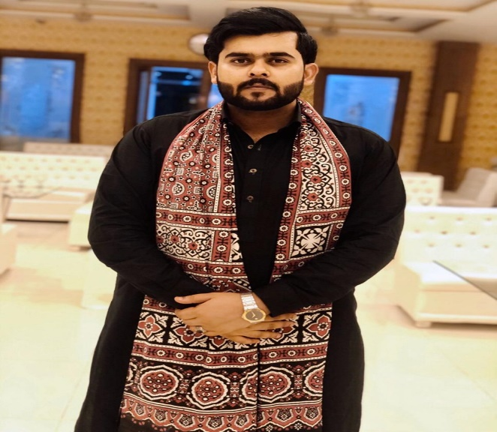
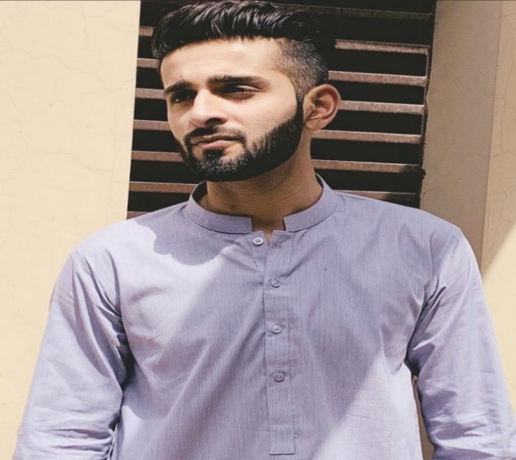
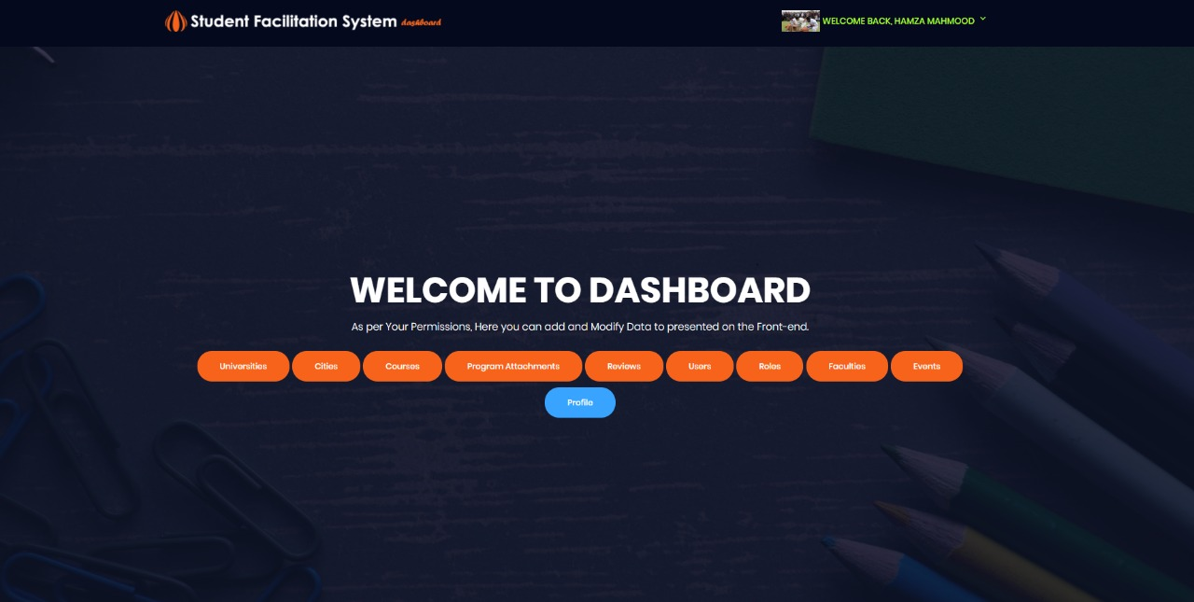
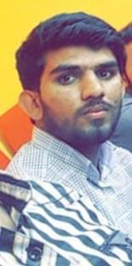
Web Based student facilitation system
Final Year Project (2016-2020) Department of Computer Science
COMSATS University of Information Technology, Lahore
INTRODUCTION
IMPLEMENTATION
OUR CONTRIBUTION
This project is basically for students who are seeking admissions in different schools, colleges and universities. This product will serve as a non-profit organization which will provide single platform for students to get all the information about the leading universities. It will provide all the information about the admission procedures, faculty staff, fee structure and their study scheme. Moreover, books related to academics along with lecture notes will be available freely. Book Solutions will also be uploaded under the supervision of experts.
Extensive research to gather information about the leading universities.
Ranking of the universities on the basis of user’s reviews.
FUTURE WORK
Till now we only focused on few major cities of Pakistan. In future, we want to go on and add multiple major cities of Pakistan in our project so that it can be more efficient and effective for the students. We also want to go deeper and focus on the “subjects” of different programs in different universities and share the books and lecture notes of the subjects instead of whole programs. We also want to add a feature of comparing different programs of the different universities so that the student can compare.
MOTIVATIONS
The main motivation is that students from other cities and foreign students can get all the information about different universities. It will save money and time. Moreover the students who can’t afford the books will be able to study them without paying to anyone.
FLOW CHART
GROUP MEMBERS
OBJECTIVES
This product is for the facilitation of students who are confused to choose between different universities to boost their career. This product will help student to choose the institute which is best for them according to their needs. No one should suffer because of lack of information or lack of resources. And that will lead us to our main objective of building a non-profit organization which guide students to select what’s best for them.
  Hamza Mahmood
  hamzamahmood755@gmail.com
  M. Alamgir Khan
  23aalamkhan@gmail.com
  Waqas Nosher
  waqas.nosher2@gmail.com
  Supervisor Co-Supervisor
  Dr. Atif Saeed Mr. Junaid Anjum
  Assistant Prof (CS) Lecturer (CS)
RESULT
CONCLUSION
This product will serve as a non-profit organization which will provide single platform to students to get all the information about the leading universities. The system will give the best guidelines to the students so that they can choose their institute according to their needs. This product will also allow users to upload and download free books and lecture notes of the programs of their choice.
TOOLS AND TECHNIQUES
    C#,HTML, CSS,BOOTSTRAP
    ASP.NET
    Entity framework,MVC5 Framework

